Slide 1


Exploring Heart Disease Risk Factors
A comprehensive analysis of the UCI Heart Disease Dataset to uncover patterns and identify key risk factors through data science
ITDS – 1471 Data Analysis Using Python
By Mehedi OP, Helena Manuel, and Jiamei Wu

Slide 2
Project Outline
An overview of the major sections covered in this presentation
01
02
Introduction
Data Processing
Setting the stage for our project: goals, scope, and the healthcare problem we will explore using data science techniques.
The systematic process of preparing raw medical data for analysis, addressing inconsistencies, mapping categories, and ensuring data quality.
03
04
Investigated Questions
Conclusion
Exploring five core research questions our analysis seeks to answer regarding heart disease risk factors and patient characteristics.
Summarizing our findings, key takeaways, and potential future directions for cardiovascular research and preventive healthcare.

Slide 3

01. Introduction
The Dataset
Our Approach
The Heart Disease UCI Dataset provides comprehensive health metrics for 1,025 patients, capturing critical indicators including age, sex, cholesterol levels, blood pressure readings, and confirmed heart disease diagnoses.
Using Python's powerful data science libraries, Pandas, NumPy, Matplotlib, and Seaborn, we systematically analyze patient characteristics to identify meaningful patterns.
This rich dataset enables us to explore complex relationships between patient characteristics and cardiovascular outcomes, offering insights into preventive care strategies.
We formulated five core questions investigating age distribution, gender differences, cholesterol and blood pressure correlations, and multivariate risk factors.
Through data manipulation techniques and visual exploration, we aim to uncover insights that could inform early detection strategies and preventive healthcare interventions.

Slide 4
02. Data Processing
This section outlines our data cleaning process, focusing on how categorical features were systematically mapped to descriptive labels for clarity and interpretability.
Sex
Chest Pain Type
Resting ECG Results
0 → Female
0 → Typical angina
0 → Normal
1 → Male
1 → Atypical angina
1 → ST-T wave abnormality
2 → Non-anginal pain
2 → Left ventricular hypertrophy
3 → Asymptomatic
Slope of Peak Exercise
Major Vessels (Fluoroscopy)
Thal
0 → Sloping Up
Values range 0–3 representing actual count of vessels colored by fluoroscopy
0 → Normal
1 → Flat
1 → Fixed defect
2 → Sloping Down
2 → Reversible defect
Continuous Variable Normalization
Derived Features
Age → normalized (Z-score and Min–Max scaling)
Age bins → grouped into ranges (20–29, 30–39, …)
Resting blood pressure → normalized
Cholesterol risk → Normal, Borderline, High
Cholesterol → normalized
Blood pressure risk → Normal, Elevated, Hypertension
Maximum heart rate → normalized
Interaction term → Age × Cholesterol
Oldpeak (ST depression) → normalized

Slide 5
03. Five Core Research Questions
1
Age Distribution Analysis
How does age correlate with heart disease prevalence across different patient groups?
2
Gender Differences
What patterns emerge when comparing heart disease rates between male and female patients?
3
Cholesterol Correlations
How do cholesterol levels relate to heart disease diagnosis and severity?
4
Blood Pressure Relationships
What role does blood pressure play in predicting cardiovascular disease outcomes?
5
Multivariate Risk Factors
How do multiple health metrics interact to influence overall heart disease risk?

Slide 6
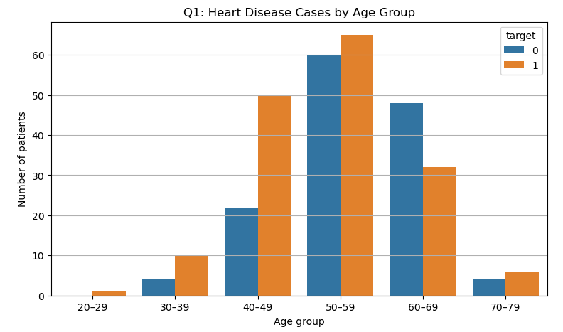
Q1: What is the distribution of heart disease across different age groups?
Bar chart that shows the number of cases for each age group
Identifies the age groups that have the highest and lowest number of heart disease patients
0 – Female
1 - Male

Slide 7
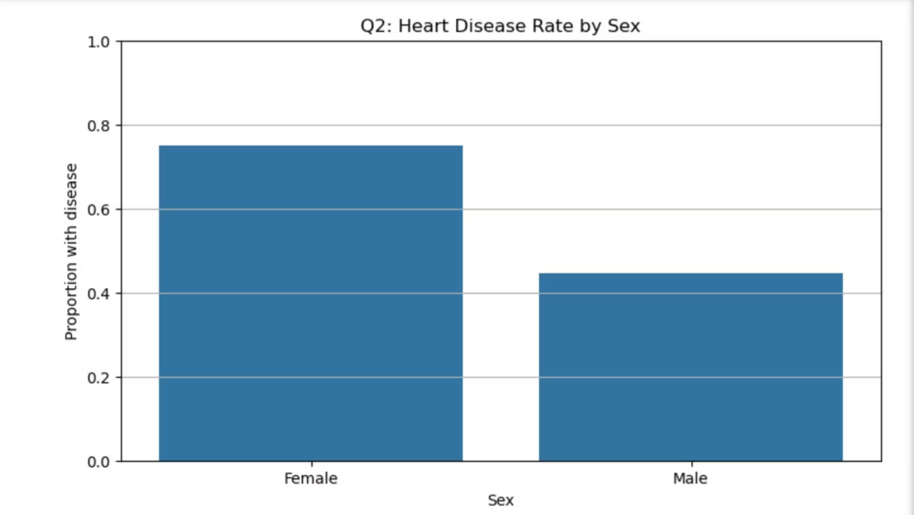
Q2: Is there a significant difference in heart disease prevalence between genders?
Bar chart comparing female and male proportions side by side
Examines the differences in heart disease rates between both men and women; can be used and applied in discovering risk patterns that have to do with gender

Slide 8
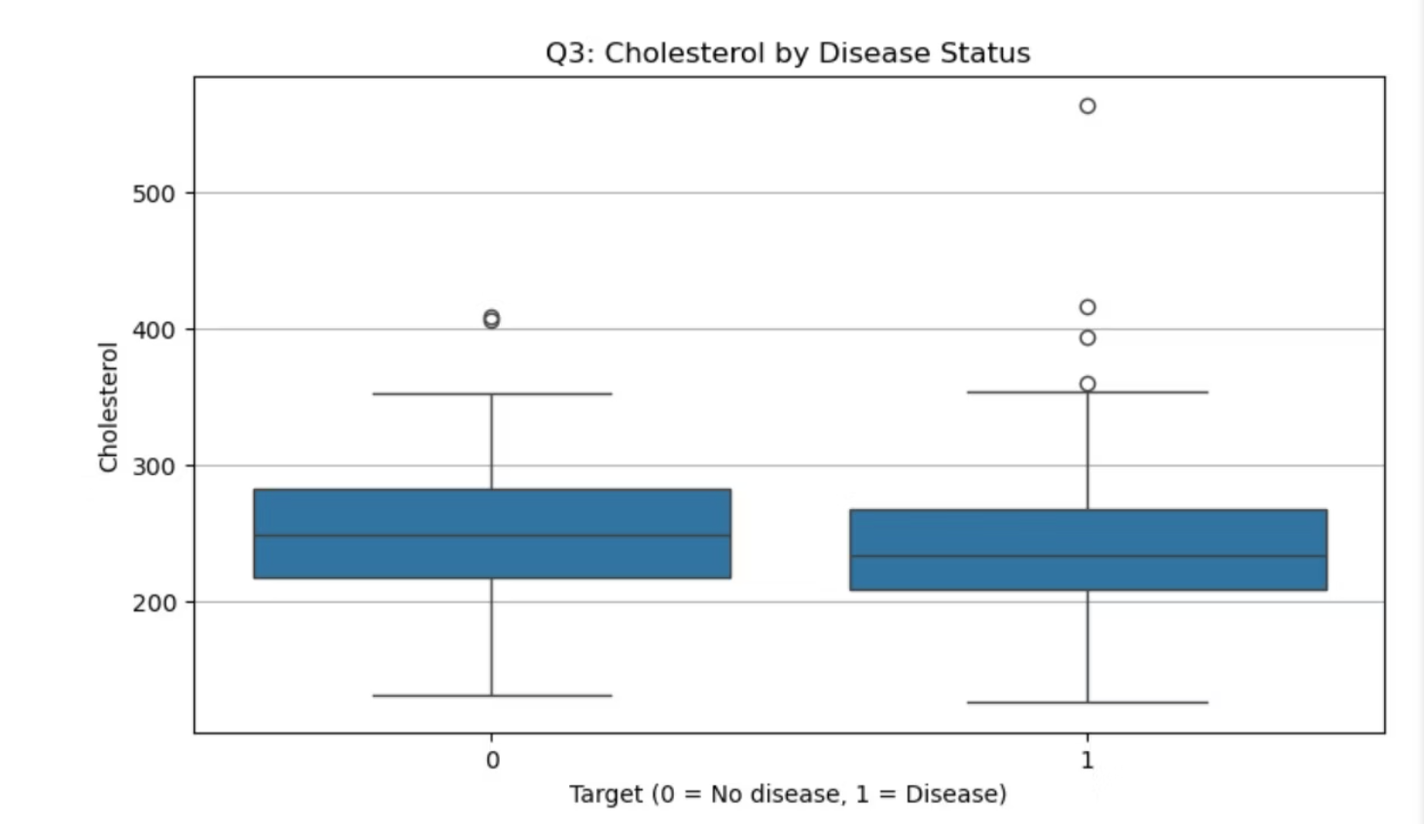
Q3: How does cholesterol level correlate with heart disease diagnosis?
Boxplot displaying cholesterol levels for people with and without heart disease diagnoses. Includes quartile ranges and outliers of the data.
Investigates whether or not cholestorol levels can change depending on the individual's heart disease status.

Slide 9
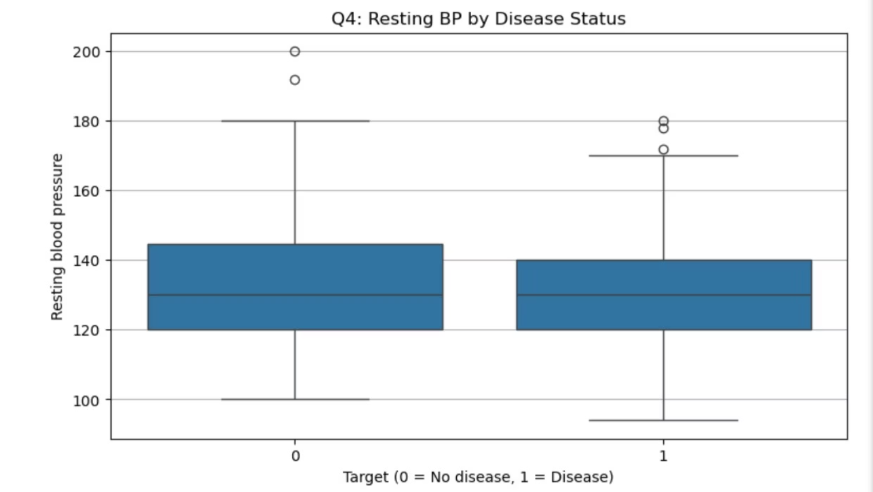
Q4: What is the relationship between resting blood pressure and heart disease?
Boxplot showing Resting_bp distribution by target. Similarly to Question 4, it investigates whether or not resting blood pressure can change based on heart disease status.

Slide 10
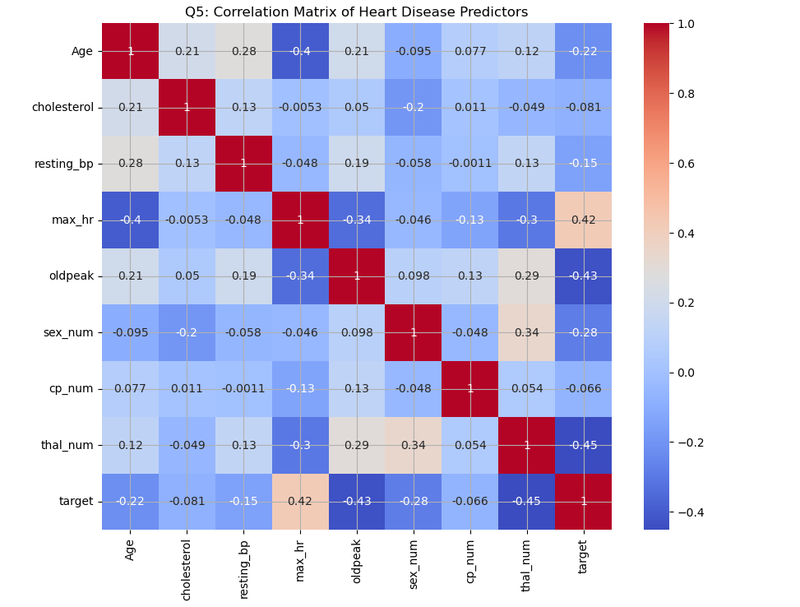
Q5: Which combination of features most strongly predicts heart disease?
Heat map showing various difference heart disease predictors and their combinations.
Examines multiple features at the same time to identify the strongest combination; can be used to build a comprehensive risk profile.

Slide 11


04. Conclusion
The key findings and answers to each of our questions
People aged 50–59 have the highest number of heart disease cases.
Heart disease rates are higher in females (~76%) than males (~42%).
Cholesterol levels are generally similar between those with and without heart disease.
Resting blood pressure shows no strong difference between groups.
People with atypical angina have the highest heart disease rates.

Slide 12





Impact & Future Directions
Our analysis of the UCI Heart Disease Dataset provides valuable insights that can influence real-world healthcare strategies and guide future research efforts.
Real-world Implications
Tailored prevention programs for 50-59 age group.
Gender-specific awareness campaigns targeting women.
Focus on atypical angina symptoms in early detection.
Limitations
Dataset may not reflect current medical advancements.
Reliance on a single dataset for broader conclusions.
Limited demographic and lifestyle factor details.
Future Research Directions
Investigate specific risk factors for women over 50.
Explore the impact of atypical angina in diverse populations.
Integrate genetic and environmental factors in analysis.
Healthcare Applications
Develop targeted screening protocols for high-risk groups.
Enhance physician training on atypical symptom recognition.
Inform public health campaigns with data-driven insights.

Slide 13

Thank You
Link to the Heart Disease UCI Dataset:
https://www.kaggle.com/datasets/johnsmith88/heart-disease-dataset

